Slide 1
Analysis of the Graph Coloring Problem
Joshua Sziede

Slide 2
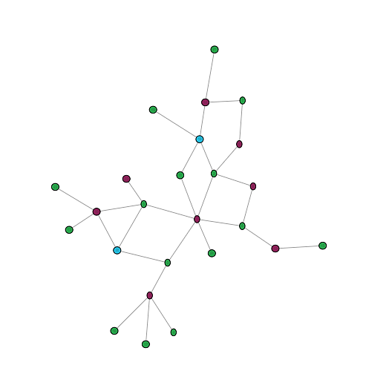
About the Graph Coloring Problem
Background
Given a graph, color all nodes so that each node does not share a color with any of its adjacent nodes.
Optimally the graph would use the least amount of colors as possible.
Finding the optimal coloring of a graph is NP-Hard.
Figure 1 An optimally colored graph

Slide 3
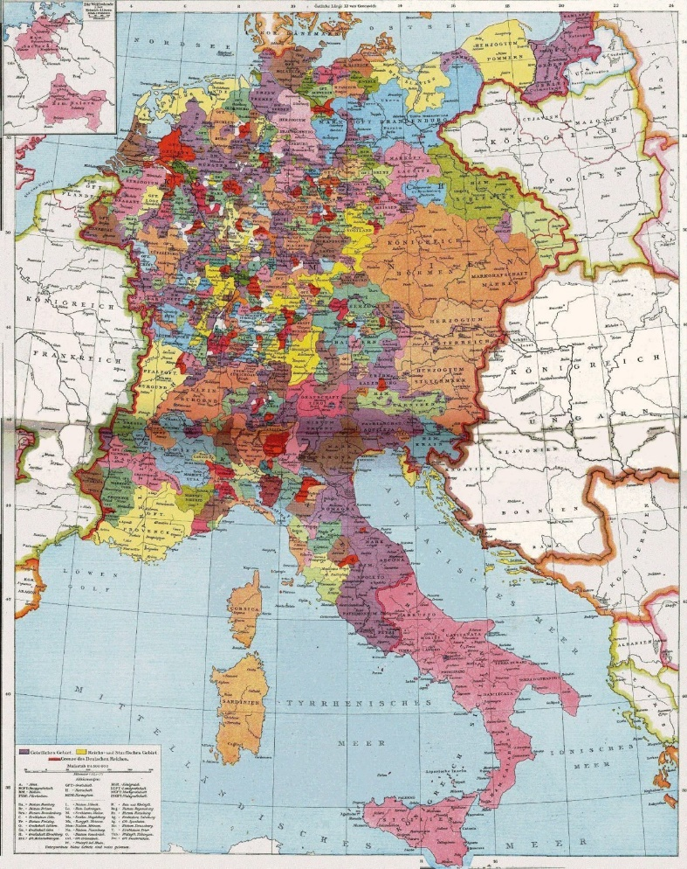
About the Graph Coloring Problem
Figure 2 Map of the Holy Roman Empire, 1250 AD
Applications
Giving bordering territories distinguishing colors in map making.
Scheduling, such as assigning airplanes to specific flights and performing separate tasks on multicore processors.
Optimal placement of security cameras to monitor the entirety of a gallery while using the minimal amount of cameras

Slide 4
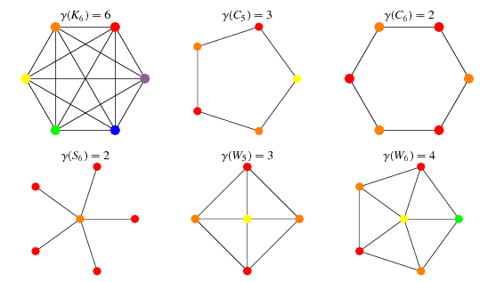
Useful Graph Properties for Solving the GCP
Chromatic Number
The chromatic number of a graph G is the smallest number of colors required for an optimal graph coloring.
Often denoted as χ(G) or ϒ(G).
Certain graph classes have a determined chromatic number, such as bipartite graphs having a ϒ(G) = 2.
Figure 3 The chromatic number of various graph classes

Slide 5
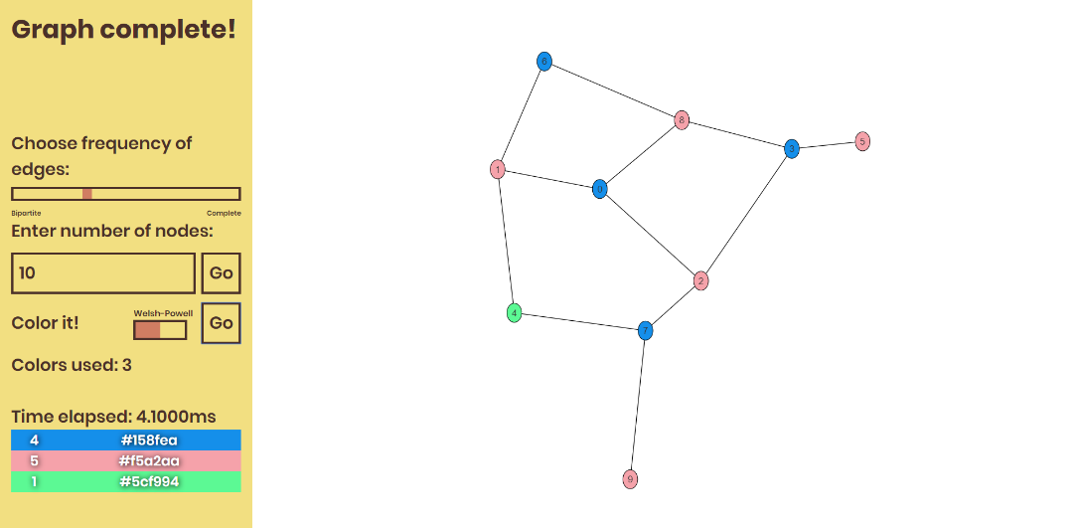
Implementing the GCP
Development
Browser-based application built using JavaScript.
Graph visualization built using the vis.js library.
Available to use at https://rawgit.com/jsziede/CS4310-Project/master/index.html
Graphs are stored as an adjacency list, giving the algorithms a space complexity of O(n + e), where n is the number of nodes and e is the number of edges.
Figure 4 The application interface

Slide 6
Implementing the GCP
Greedy Algorithms
For any given graph with no known properties, GCP is solved using two greedy algorithms: one denoted simply as Greedy and another denoted as Welsh-Powell.
These greedy algorithms are not optimal.
Optimal Algorithms
Based on what we know about a graph’s chromatic number, two optimized algorithms exist for graphs that are known to be complete or bipartite.
Many more optimized algorithms exist for many other types of graphs, but I only use the above two optimizations for brevity.

Slide 7
Greedy Algorithms
Greedy Algorithm
The Greedy algorithm iterates over all nodes, used colors, and edges.
Colors each node in order of the node’s id, e.g. where n = 10, node 0 is colored first and node 9 is colored last.
Theoretical time complexity of
O(n² * e).
Generate random color
Color node with first id with the random color
Add color to list
For each node after the first in increasing order of node id
Get the first node adjacent to the current node
For each color in the list
Check if adjacent node has the current color
If yes, move to the next color
If no, get the next adjacent node
If no other adjacent nodes
Set current node’s color to the current color
If all colors were found on an adjacent node
Generate new random color
Color current node with the new random color
Add color to list
Example 1 Pseudocode of the Greedy algorithm

Slide 8
Greedy Algorithms
Welsh-Powell Algorithm
The Welsh-Powell algorithm is a more optimized version of the Greedy algorithm in terms of colors used.
Colors nodes in order of highest to lowest degree.
Generally uses less colors than the Greedy algorithm, but not always.
Same theoretical time complexity as the Greedy algorithm.
Generate random color
Color node with highest degree with the random color
Add color to list
For each node after the first in decreasing order of degree
Get the first node adjacent to the current node
For each color in the list
Check if adjacent node has the current color
If yes, move to the next color
If no, get the next adjacent node
If no other adjacent nodes
Set current node’s color to the current color
If all colors were found on an adjacent node
Generate new random color
Color current node with the new random color
Add color to list
Example 2 Pseudocode of the Welsh-Powell algorithm

Slide 9
Experimental Results Using Greedy Algorithms
Figure 5 Results showing running times of greedy algorithms on graphs with 10% edge frequency
Figure 6 Results showing running times of greedy algorithms on graphs with 40% edge frequency
Figure 7 Results showing running times of greedy algorithms on graphs with 70% edge frequency
At x% edge frequency, for each other node, there is an x% chance the current node will connect to it.
Note that this graph only uses 1200 nodes at most rather than 1600.

Slide 10
Experimental Results Using Greedy Algorithms
Figure 8 Results showing the amount of colors used for greedy algorithms on graphs with 10% edge frequency
Figure 9 Results showing the amount of colors used for greedy algorithms on graphs with 40% edge frequency
Figure 10 Results showing the amount of colors used for greedy algorithms on graphs with 70% edge frequency
Note that this graph only uses 1200 nodes at most rather than 1600.

Slide 11
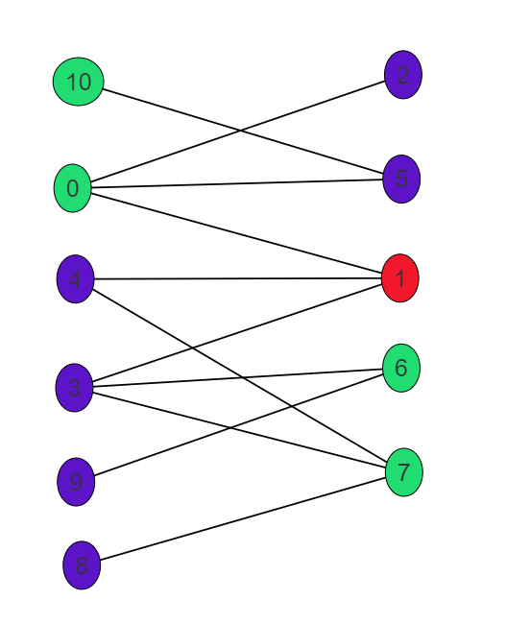
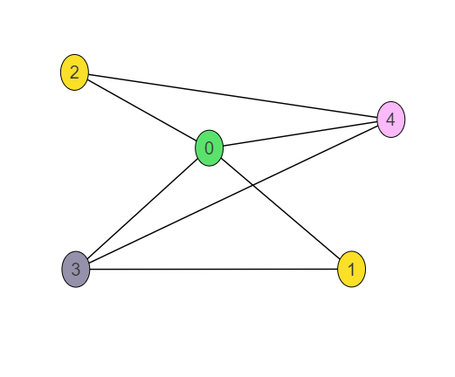
Conclusion of Greedy Algorithms
Interpretation of Data
Welsh-Powell always found the same or less colors than the Greedy algorithm in my tests.
The more edges there are in proportion to nodes, the less efficient the Greedy algorithm is.
Empirical time complexities match the theoretical time complexity.
Time increases as edge frequency increases.
Room for Improvement
The running times of graphs with over 10,000 nodes would be unreasonable.
The two greedy algorithms do not guarantee optimal coloring.
Determining the optimal solution would require running a greedy algorithm for every possible combination of nodes, resulting in a highly inefficient time complexity.
Figure 11 A non-optimal Welsh-Powell coloring of a bipartite graph
Figure 12 A non-optimal Greedy coloring of a tripartite graph

Slide 12
Optimized Algorithms
Chromatic Properties
Knowing that all bipartite graphs only need two colors, we can write a separate algorithm that only uses two colors to optimally color the graph if we know the input graph is bipartite.
Similarly, we can write another separate algorithm to color all nodes in a complete graph a unique color.
Both algorithms have a theoretical time complexity of O(n).
Generate two random colors
Color node with first id with the first random color
Add both colors to list
For each node after the first in increasing order of node id
Get the first node adjacent to the current node
If the adjacent node’s color is that of the first color in the list
Color the current node with the second color in the list
Else color the current node the first color in the list
Example 3 Pseudocode of the Bipartite algorithm
Generate a random color
Color node with first id with the random color
Add color to list
For each node after the first in increasing order of node id
Generate a new random color
Color current node with the new random color
Add color to list
Example 4 Pseudocode of the Complete algorithm

Slide 13
Experimental Results Using Optimized Algorithms
Figure 13 Results showing running times of optimized algorithms on complete graphs
Figure 14 Results showing running times of optimized algorithms on bipartite graphs
Note that this graph only uses 1200 nodes at most rather than 1600.
Note that this graph uses 2000 nodes at most rather than 1600.

Slide 14
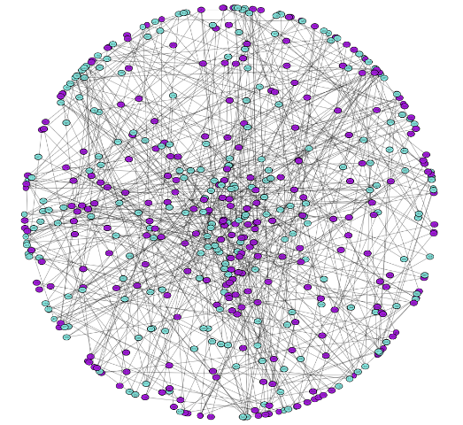
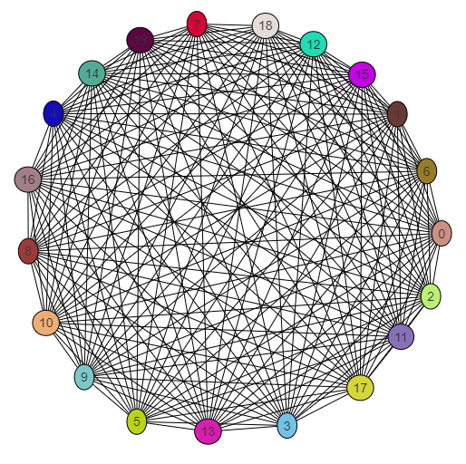
Conclusion of Optimized Algorithms
Interpretation of Data
Both algorithms ran incredibly fast.
Empirical time complexities match the theoretical time complexity.
While not pictured in the data, both algorithms always produced the expected coloring.
Figure 14 An optimal coloring of a bipartite graph
Figure 15 An optimal coloring of a complete graph

Slide 15
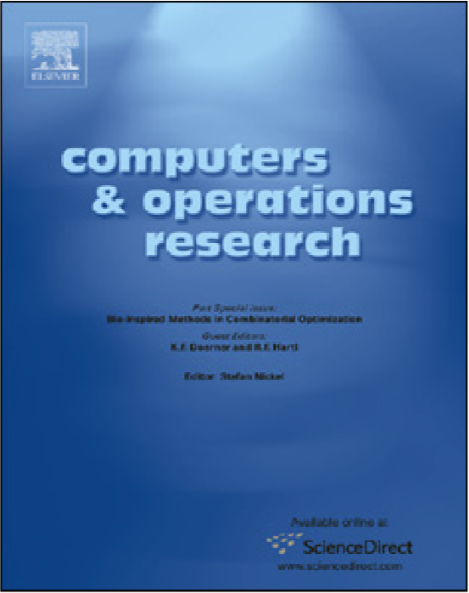
Advanced Techniques for Solving the GCP
Academic Paper
An exact algorithm with learning for the graph coloring problem by Zhaoyang Zhou, Chu-Min Li, Chong Huang, Ruchu Xu
Uses an exact algorithm to solve the GCP, meaning it will always produce an optimal solution.
Figure 16 Cover of the journal the academic paper was published in

Slide 16
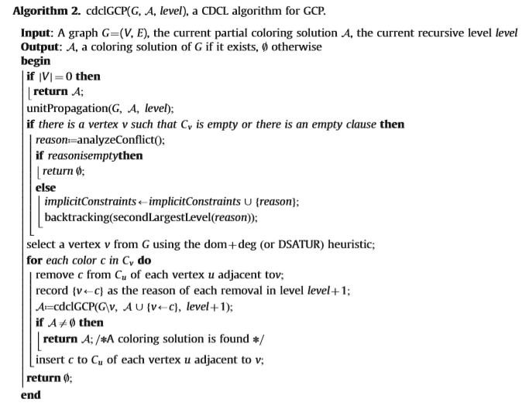
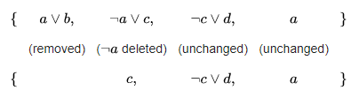
Advanced Techniques for Solving the GCP
Figure 17 Pseudocode of the proposed algorithm for solving the GCP
Understanding the Pseudocode
CDCL refers to the Conflict Driven Clause Learning algorithm, which is used to solve the Boolean satisfiability problem (assigns variables to a Boolean formula so it will evaluate to true).
Unit propagation is a method to simplify a set of logical clauses.
Figure 18 An example of unit propagation

Slide 17
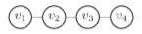
Advanced Techniques for Solving the GCP
Figure 17 Pseudocode of the proposed algorithm for solving the GCP
Understanding the Pseudocode
Implicit constraints refers to constraints between nodes that are not adjacent to each other.
Backtracking is an algorithmic technique that recursively examines alternative steps to a problem and uses the better option to move closer to a solution.
Figure 19 Even though v1 and v4 are not adjacent, they cannot share a color in an optimal coloring solution

Slide 18
Advanced Techniques for Solving the GCP
Figure 17 Pseudocode of the proposed algorithm for solving the GCP
Putting It All Together
The proposed CDCL GCP algorithm takes a partially colored graph and searches for implicit constraints using the CDCL algorithm and unit propagation, using the results to reduce the search space.
Using the implicit constraints, the algorithm adds newly colored nodes to the partially colored graph based on the current recursive level.
The recursive level is defined as the distance of the node from the root.

Slide 19
Comparing Results
Results
My greedy algorithms performed much faster in most cases.
Typically the CDCL GCP results would use half or a third as many colors.
Reasoning
The CDCL GCP algorithms were run on graphs specifically made for benchmarking, I only simulated approximate graphs.
The computer used for the CDCL GCP was about half as powerful as mine.
Greedy algorithms do not examine clauses and implicit constraints.
Table 1 CDCL GCP runtimes compared to greedy runtimes.
Nodes | CDCL GCP (ms) | Greedy (ms)
52 | 10 | 7
88 | 0.1 | 0.2
191 | 1340 | 2
282 | 40 | 440
300 | 13440 | 112
450 | 410 | 147
662 | 330 | 6.8
852 | 890 | 141
1085 | 1560 | 101
1216 | 2000 | 6.8
1557 | 8490 | 123

Slide 20
Sources
Bayardo Jr., Roberto J.; Schrag, Robert C.. "Using CSP look-back techniques to solve real world SAT instances" (PDF). Proc. 14th Nat. Conf. on Artificial Intelligence (AAAI). 1997, pp. 203–208.
Droysen, Gustav. “Heiliges Römisches Reich um 1250.” Allgemeiner historischer Handatlas, 1886, https://upload.wikimedia.org/wikipedia/commons/d/d9/Heiliges_R%C3%B6misches_Reich_um_1250.png.
Erickson, Jeff. “Algorithms Lecture 3: Backtracking.” University of Illinois, 2014, https://web.engr.illinois.edu/~jeffe/teaching/algorithms/notes/03-backtracking.pdf.
LeBlanc, Jennifer. “Vertex Coloring: Welsh-Powell Algorithm.” PBWorks, 2011, http://mrsleblancsmath.pbworks.com/w/file/fetch/46119304/vertex%20coloring%20algorithm.pdf.
Marques-Silva, J.P.; Sakallah, Karem A.. "GRASP-A New Search Algorithm for Satisfiability". Digest of IEEE International Conference on Computer-Aided Design (ICCAD). November 1996, pp. 220–227., doi:10.1109/ICCAD.1996.569607.
Shamim, Ahmed. “Applications of Graph Coloring in Modern Computer Science .” International Journal of Computer and Information Technology, vol. 3, 2012.
Weisstein, Eric W. "Chromatic Number." From MathWorld--A Wolfram Web Resource. http://mathworld.wolfram.com/ChromaticNumber.html
Zhou, Zhaoyang, et al. “An Exact Algorithm with Learning for the Graph Coloring Problem.” Computers & Operations Research, vol. 51, 2014, pp. 282–301., doi:10.1016/j.cor.2014.05.017.

